Slide 1
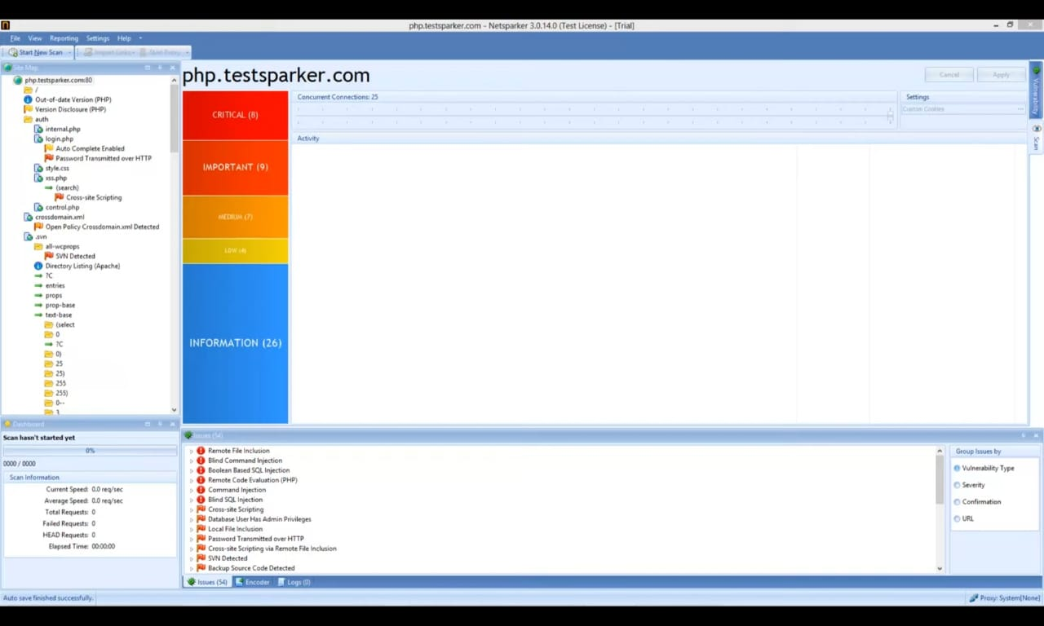
TASK 3: continue vibhuti patil

Slide 2
